Slide 1
Chalk Talk
Neural Networks

Slide 2
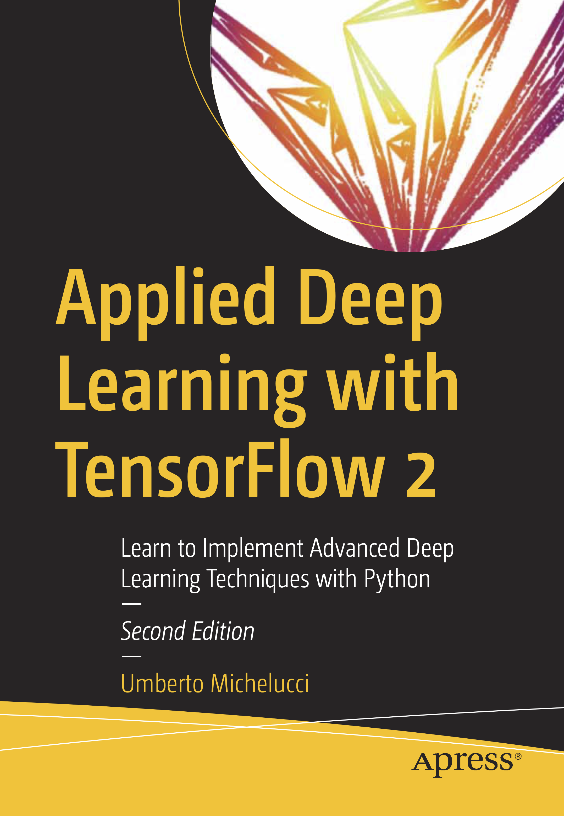
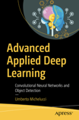
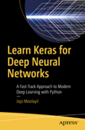
Books Suggestions #1
Advanced Applied Deep Learning with TensorFlow 2
By Umberto Michelucci
https://amzn.to/35IjLrV
Advanced Applied Deep Learning - Convolutional Neural Networks and Object Detection
By Umberto Michelucci
http://toe.lt/10
Learn Keras for Deep Neural Networks - A Fast-Track Approach to Modern Deep Learning with Python
By Moolayil, Jojo John
http://toe.lt/11

Slide 3

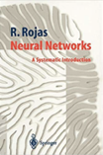
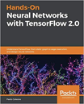
Books Suggestions #2
Hands-on Machine Learning with Scikit-Learn, Keras, and TensorFlow:
Concepts, Tools, and Techniques to Build Intelligent Systems (2nd Ed.)
By Aurelien Geron
http://toe.lt/12
Neural Networks: A Systematic Introduction By Raul Rojas
http://toe.lt/13
Hands-On Neural Networks with TensorFlow 2.0: Understand TensorFlow, from static graph to eager execution, and design neural networks
By Paolo Galeone
http://toe.lt/15

Slide 4
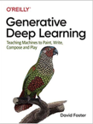
Books Suggestions #3
Generative Deep Learning
By David Foster
http://toe.lt/14

Slide 5
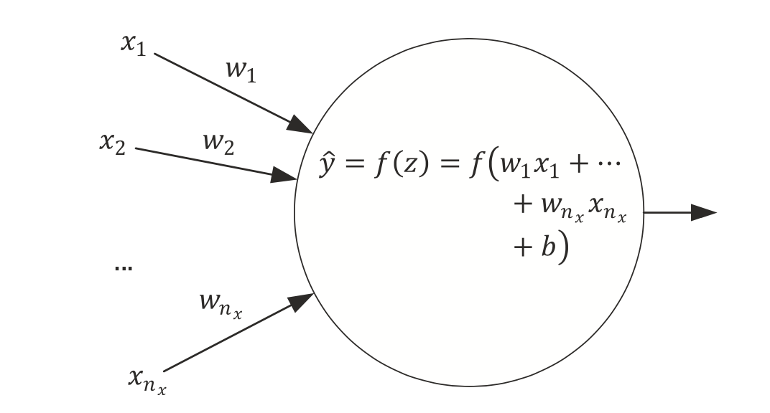
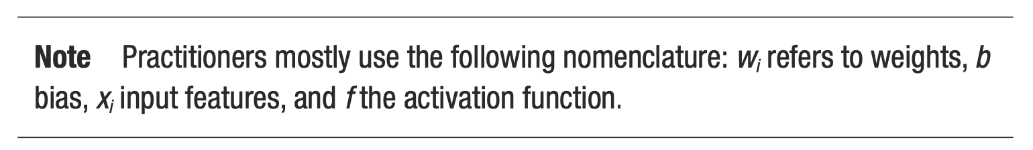
Simplest network possible
The simplest neural network that we can create is made of one single neuron.
Source:Umberto Michelucci, Applied Deep Learning - A Case-Based Approach to Understanding Deep Neural Networks, APRESS 2018

Slide 6
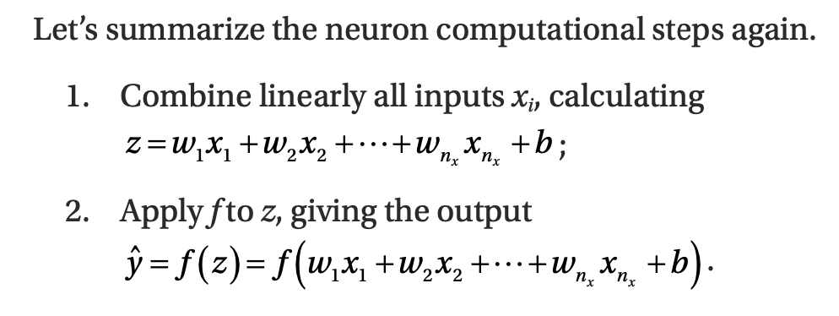
Computational Steps of a single neuron
Source:Umberto Michelucci, Applied Deep Learning - A Case-Based Approach to Understanding Deep Neural Networks, APRESS 2018

Slide 7
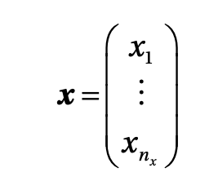
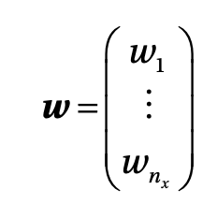
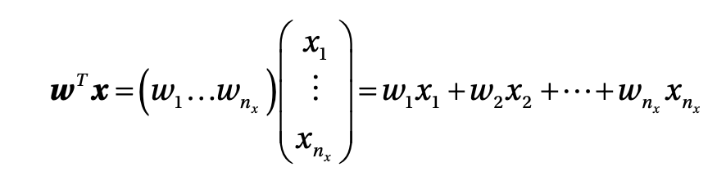
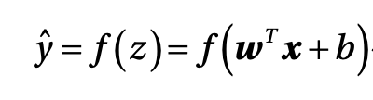
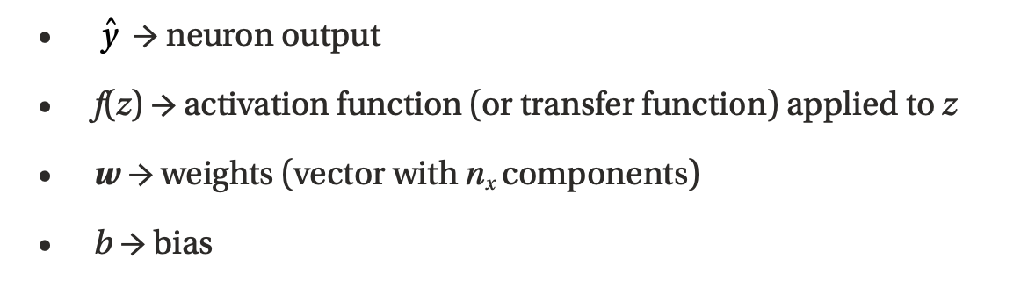
Neuron computation in matrix form
Source:Umberto Michelucci, Applied Deep Learning - A Case-Based Approach to Understanding Deep Neural Networks, APRESS 2018

Slide 8
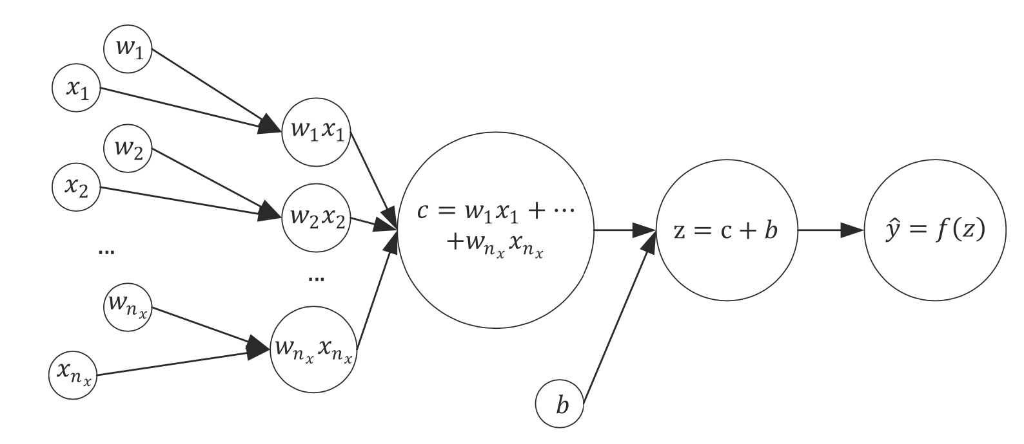
The same network seen as a computational graph
A computational graph is a directed graph where the nodes correspond to operations or variables. Variables can feed their value into operations, and operations can feed their output into other operations. This way, every node in the graph defines a function of the variables. (From: http://www.deepideas.net/deep-learning-from-scratch-i-computational-graphs/)
Source:Umberto Michelucci, Applied Deep Learning - A Case-Based Approach to Understanding Deep Neural Networks, APRESS 2018

Slide 9
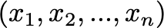
One single neuron - abstraction
Neuron
Nothing else than an operation that transform the inputs tensor into a new one

Slide 10
Learning for a neuron includes 3 steps
A neural network (defined by its architecture, in other words the computational steps to evaluate the network output)
A loss function (a function to measure how good or bad the network is predicting the outputs)
An algorithm to minimize the loss function (also called optimizer)
Source:Umberto Michelucci, Applied Deep Learning - A Case-Based Approach to Understanding Deep Neural Networks, APRESS 2018

Slide 11
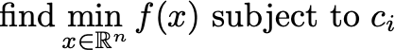
Optimization problem formulation*
Source:Umberto Michelucci, Applied Deep Learning - A Case-Based Approach to Understanding Deep Neural Networks, APRESS 2018
* Nocedal, J. and Wright S. J., Numerical Optimization, Springer Series in Operations Research

Slide 12
Neural Network learning framed as an optimization problem
weights
Loss function
Constraints as a minimum value for a metric (accuracy) or MSE, inference time, etc.*
* a different meaning that what is included in the book by Nocedal J. where the constraints are only for the variable x.

Slide 13
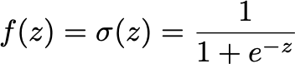
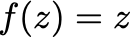
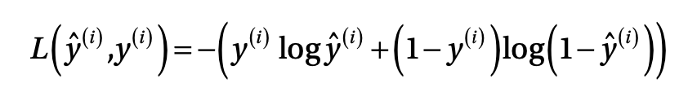
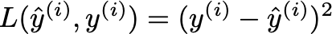
A single neuron can do a lot
Logistic regression
Linear regression

Slide 14
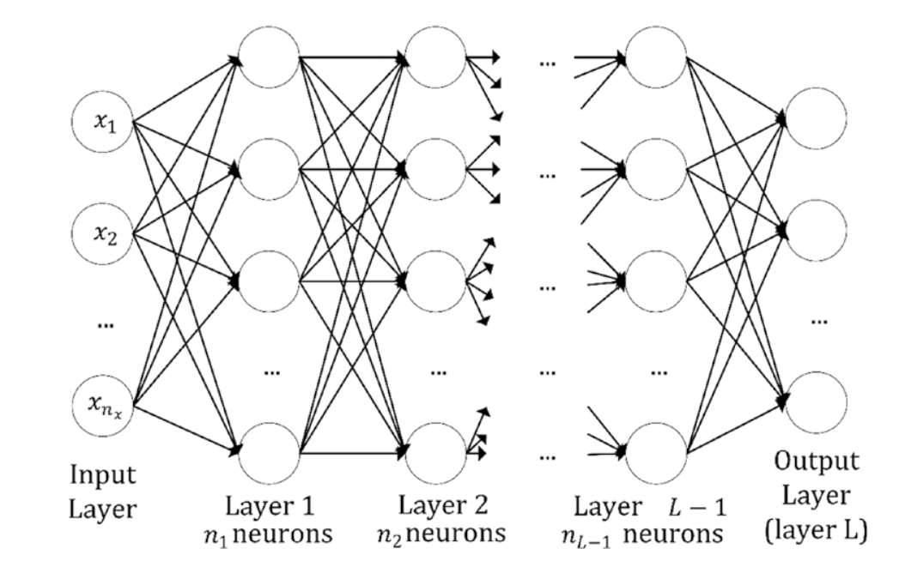
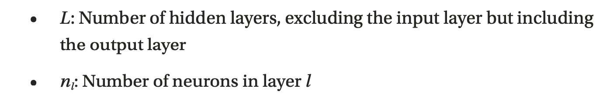
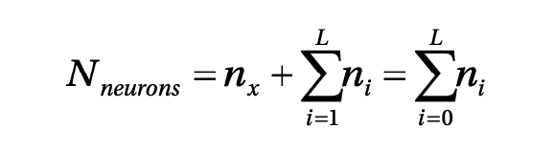
Multiple neurons / multiple layers
Source:Umberto Michelucci, Applied Deep Learning - A Case-Based Approach to Understanding Deep Neural Networks, APRESS 2018

Slide 15
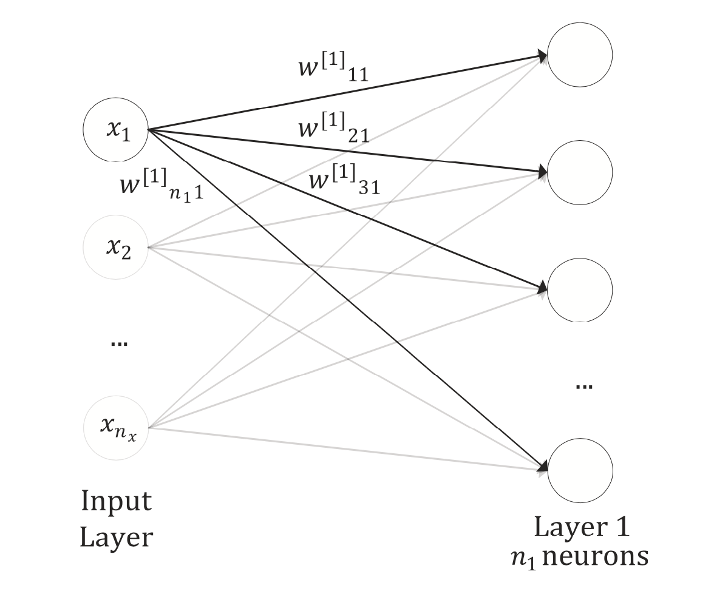
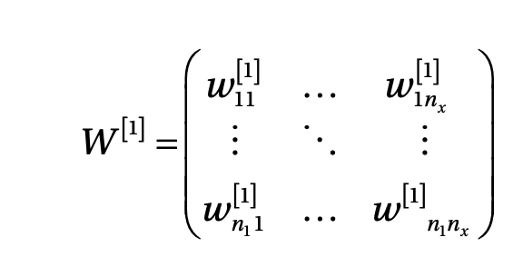
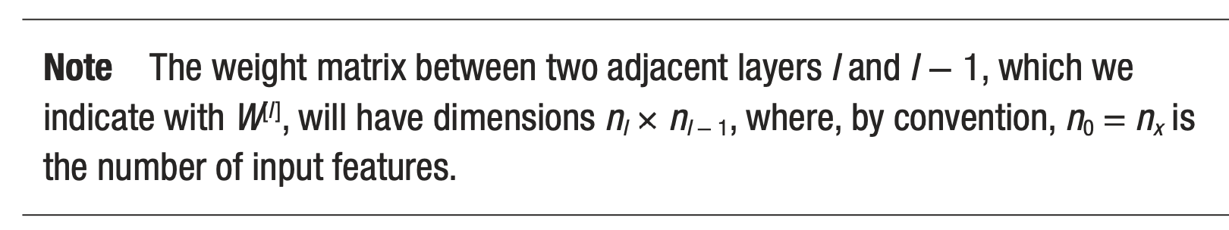
Matrix formalism for networks
Source:Umberto Michelucci, Applied Deep Learning - A Case-Based Approach to Understanding Deep Neural Networks, APRESS 2018

Slide 16
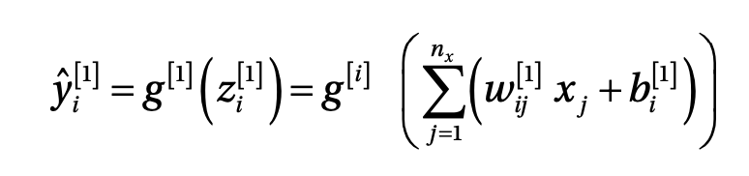
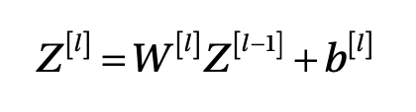
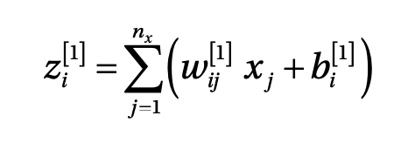
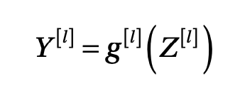
Output of neurons
Non-matrix version
Matrix version

Slide 17
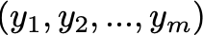
Multiple neurons - abstraction
Layer with m neurons
Nothing else than an operation that transform the inputs tensor into a new one

Slide 18
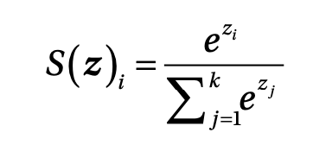
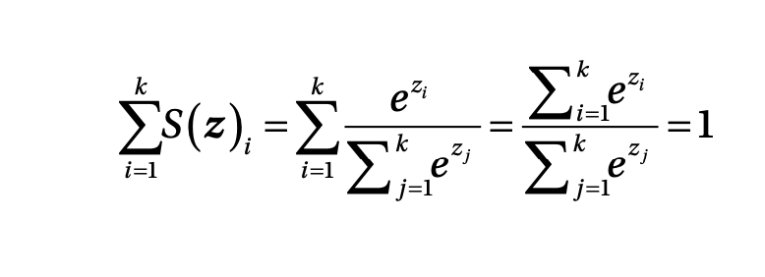
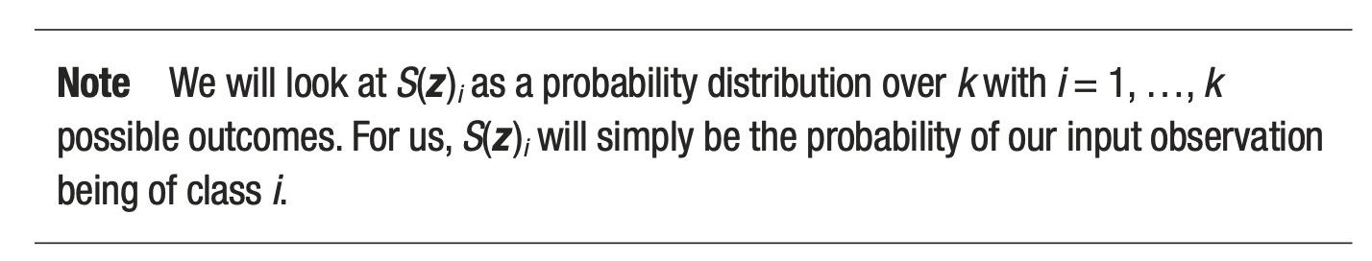
Softmax output layer for classification
Output of ith neuron of the output layer
Note that they can be interpreted as probability since the sum is equal to 1
Source:Umberto Michelucci, Applied Deep Learning - A Case-Based Approach to Understanding Deep Neural Networks, APRESS 2018

Slide 19
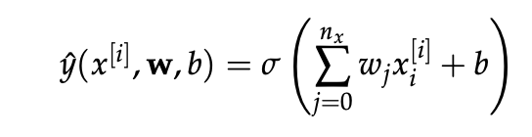
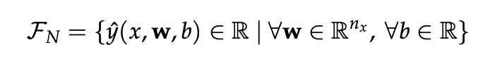
A network architecture define a set of functions (example for one single neuron)
Output of
the neuron
Set of functions defined by the architecture

Slide 20
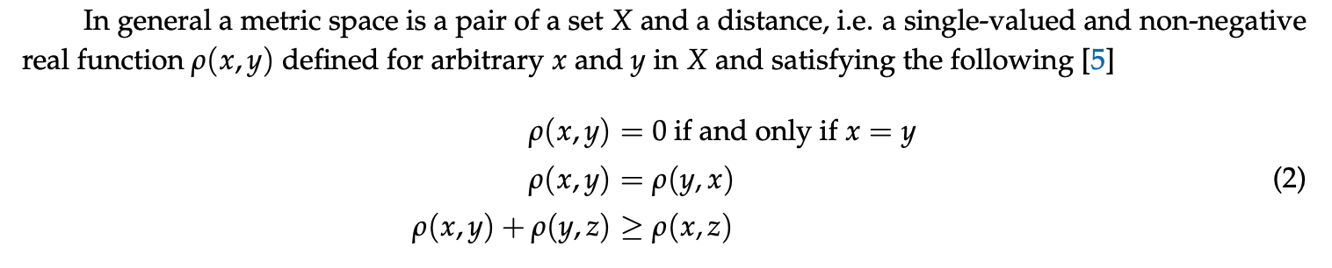
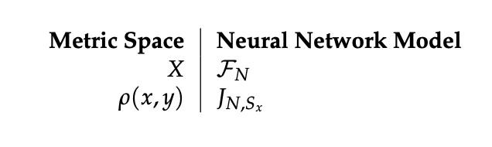
A small detour - a network model as a metric space problem

Slide 21
Neural networks in functional space language
Basically we are trying to approximate a function we don’t know how it looks like and even if it exists. By doing that we use only a few evaluations of this unknown function (we assume the labels are evaluations of this function), and with those we define a metric.

Slide 22
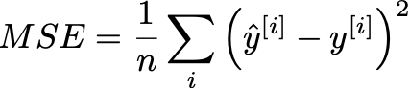
Neural networks in metric space language
Space of functions (example for one neuron)
Metric
Note how this metric depends on the dataset. Changing the dataset changes the metric space.

Slide 23
A network model can be seen as a function approximator or a “model” generator

Slide 24
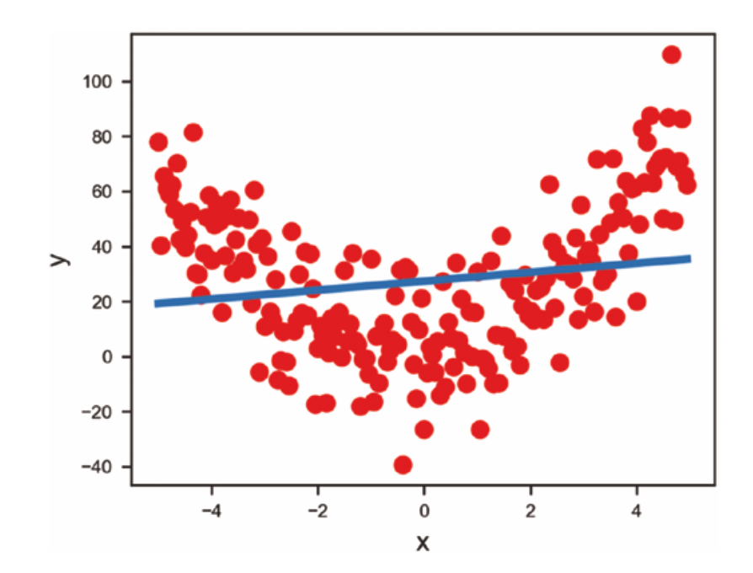
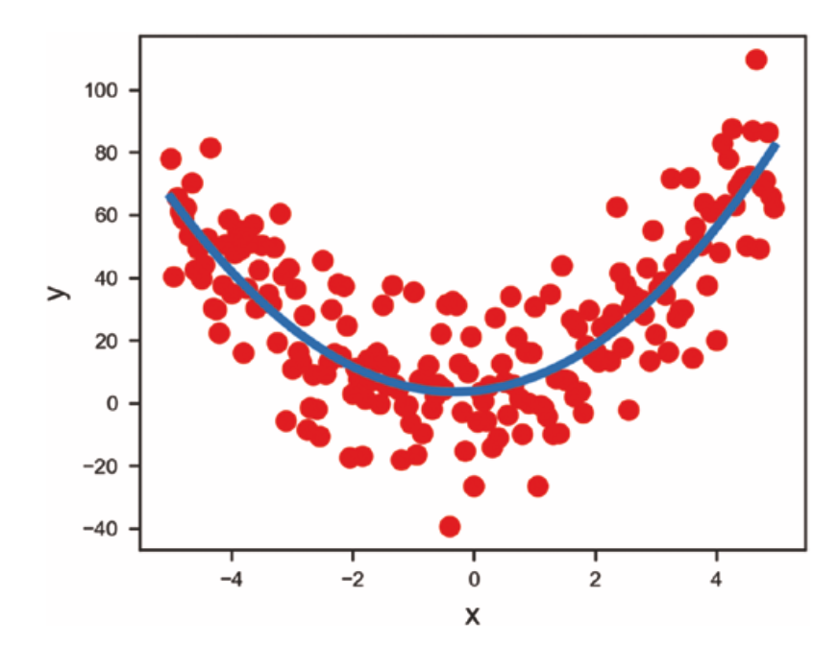
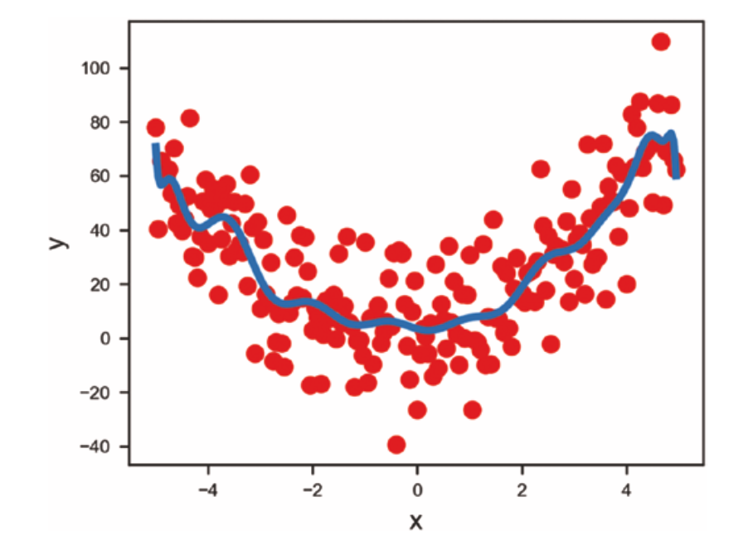
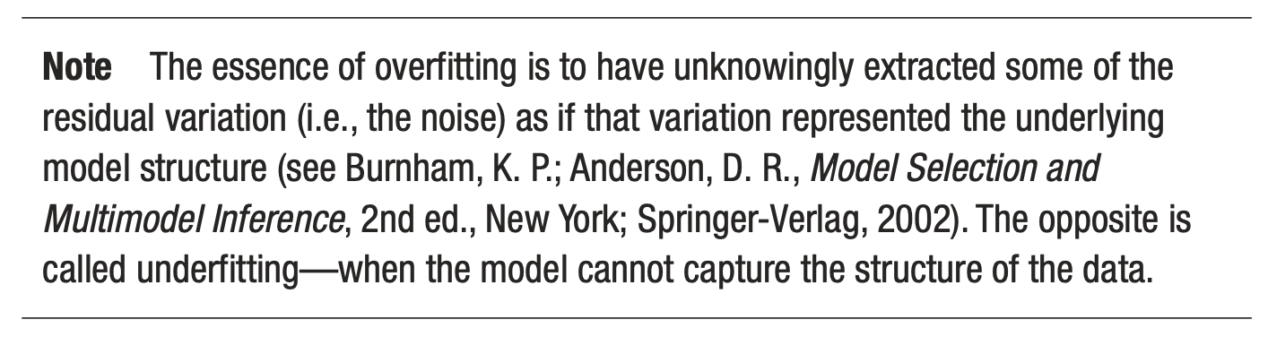
First problem - overfitting
Source:Umberto Michelucci, Applied Deep Learning - A Case-Based Approach to Understanding Deep Neural Networks, APRESS 2018
Underfitting
Just fitting ;-)
Overfitting

Slide 25
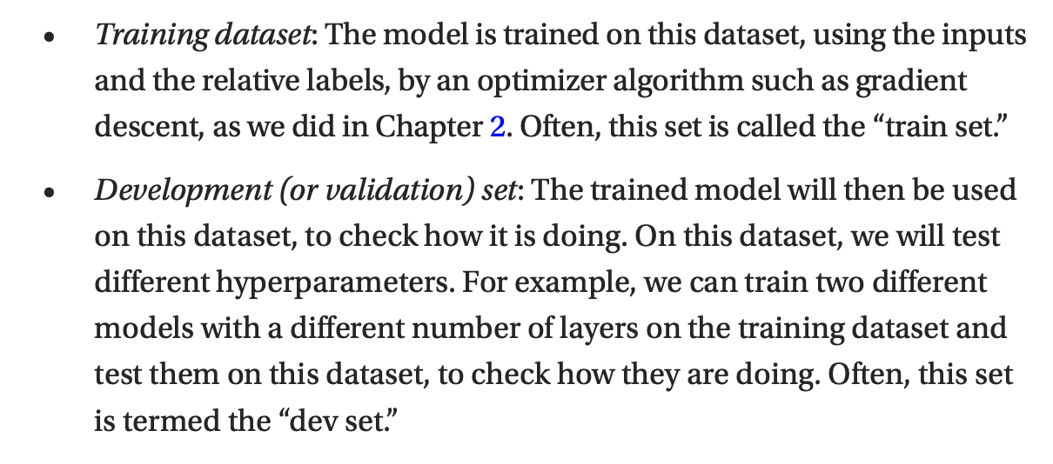
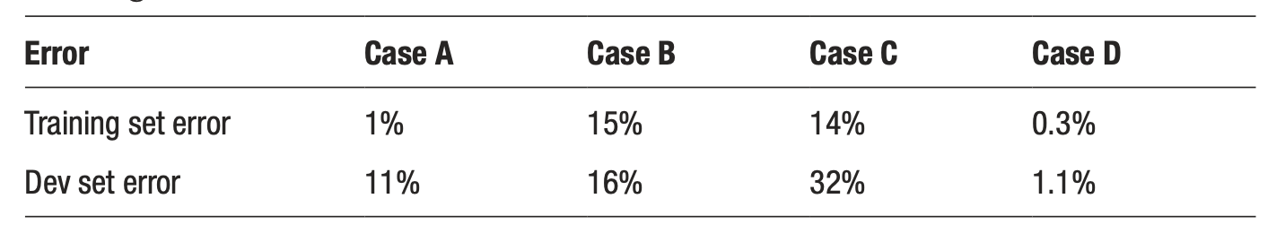
Two datasets to detect overfitting
Source:Umberto Michelucci, Applied Deep Learning - A Case-Based Approach to Understanding Deep Neural Networks, APRESS 2018

Slide 26
Optimizers

Slide 27
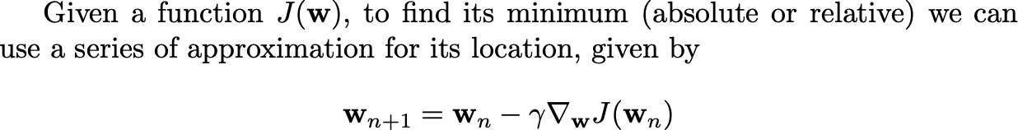
Gradient Descent

Slide 28
First challenge: the right learning rate
https://www.benfrederickson.com/numerical-optimization/

Slide 29
Gradient Descent variations
Batch - Update the weights after all observations have been evaluated
Mini-batch - Update the weights after n observations have been evaluated
Stochastic - Update the weights after each single observations have been evaluated

Slide 30
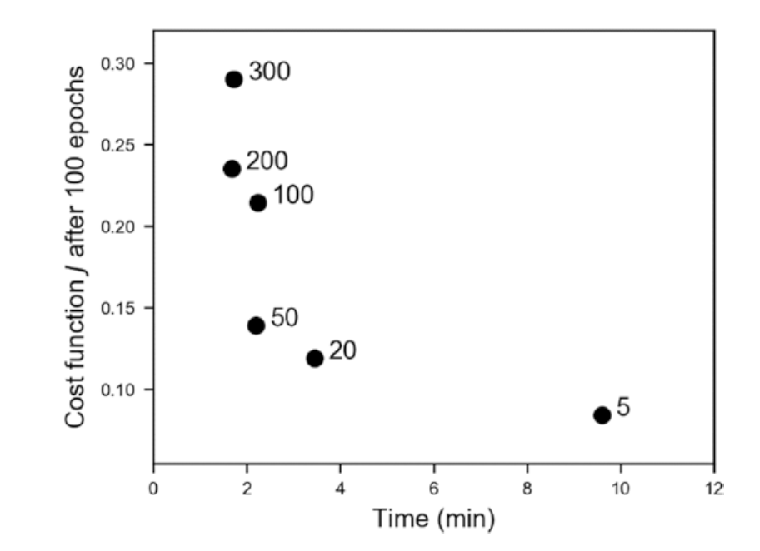
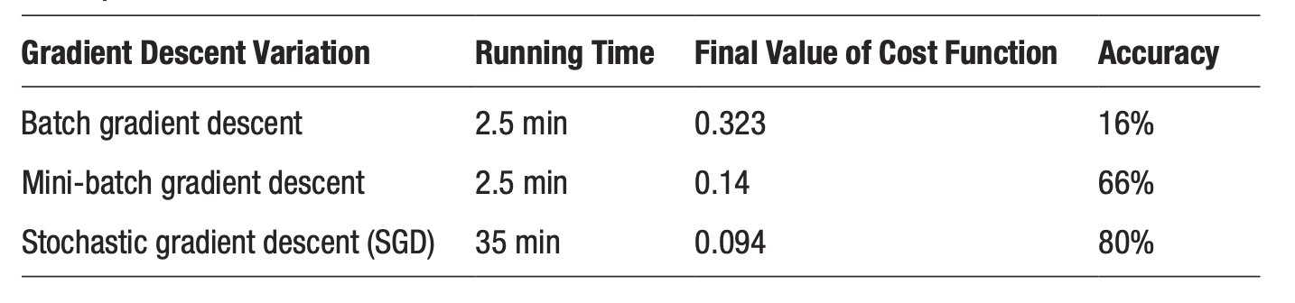
Gradient descent variations - a comparison
Source:Umberto Michelucci, Applied Deep Learning - A Case-Based Approach to Understanding Deep Neural Networks, APRESS 2018

Slide 31
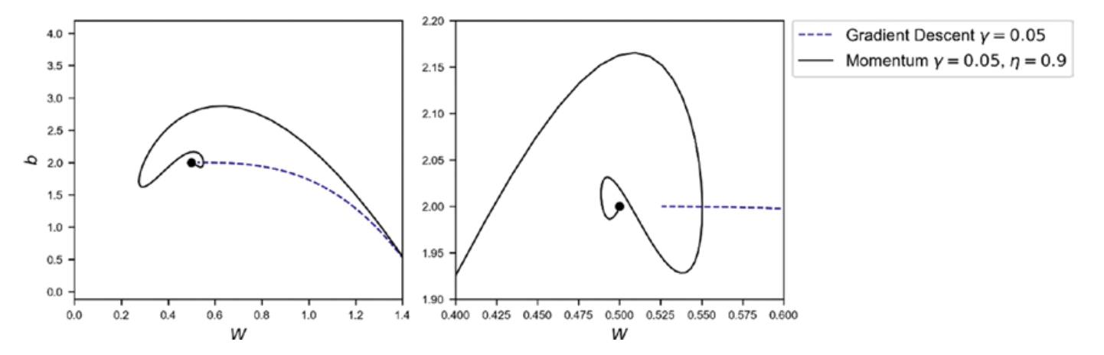
Other optimizers
Momentum
RMSProp
Adam ←
Source:Umberto Michelucci, Applied Deep Learning - A Case-Based Approach to Understanding Deep Neural Networks, APRESS 2018

Slide 32
Regularization

Slide 33



Regularization are techniques to reduce overfitting (let’s discuss…)
Source:Umberto Michelucci, Applied Deep Learning - A Case-Based Approach to Understanding Deep Neural Networks, APRESS 2018

Slide 34

Effect of regularization on the weights
With l2 regularization
Without l2 regularization
Source:Umberto Michelucci, Applied Deep Learning - A Case-Based Approach to Understanding Deep Neural Networks, APRESS 2018

Slide 35

Effect of regularization on the weights
Source:Umberto Michelucci, Applied Deep Learning - A Case-Based Approach to Understanding Deep Neural Networks, APRESS 2018

Slide 36

Effect of regularization on the weights
Source:Umberto Michelucci, Applied Deep Learning - A Case-Based Approach to Understanding Deep Neural Networks, APRESS 2018

Slide 37


Effect of regularization
Without
With

Slide 38





Are the weights really going to zero?
Close to the minimum
Similar to

Slide 39

Are the weights really going to zero?

Slide 40

L1 regularization

Slide 41
Dropout

Slide 42

A basic explanation
“During training, some number of layer outputs are randomly ignored or “dropped out.” This has the effect of making the layer look-like and be treated-like a layer with a different number of nodes and connectivity to the prior layer. In effect, each update to a layer during training is performed with a different “view” of the configured layer.” [1]
[1] https://machinelearningmastery.com/dropout-for-regularizing-deep-neural-networks/

Slide 43
Additional difficulties
Hyperparameter tuning - finding the best parameters to obtain the best values for the chosen metric
Metric analysis - detecting possible issues with the datasets
Training speed - optimizing to get the fastest training possible
Big datasets - working with amount of data that does not fit in memory anymore

Slide 44
From here the only limit is your creativity!

